Slide 1
From biological to artificial neuron
Notes:
In this lesson, we will introduce artificial neural networks as a «model» for machine learning, inspired by biological neural networks. To this aim, we first try to highlight that it is not trivial to define what intelligence is, and then what artificial neurons are and how they «learn»

Slide 2
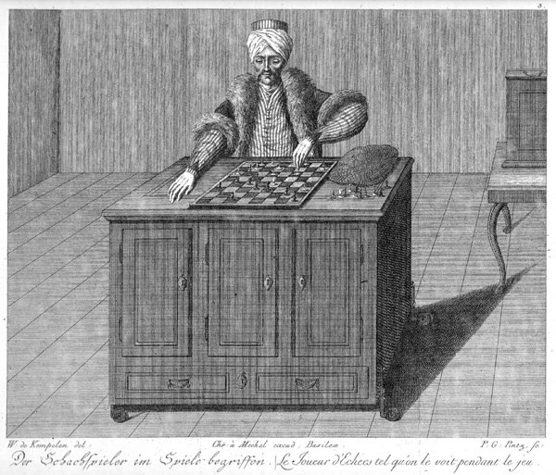
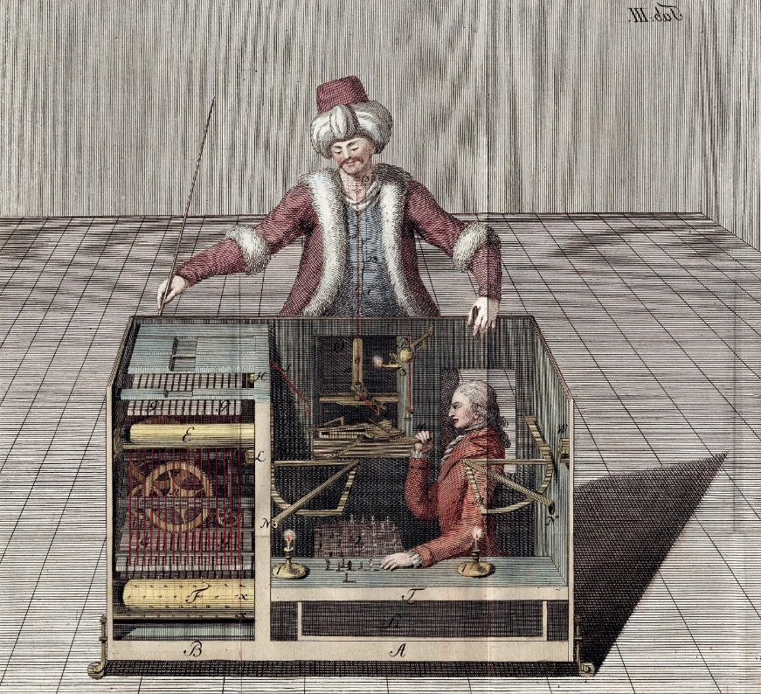
What is intelligence?
Marvin Minsky defined AI as 'the development of machines capable of doing autonomously things that would require intelligence if done by humans’
In 1700, Wolfgang von Kempelen invented the 'mechanical Turk', a machine “capable” of playing chess autonomously
Source: Wikimedia - https://en.wikipedia.org/wiki/Mechanical_Turk
Notes:
The concept of intelligence is not easy neither to define nor to model. Nonetheless, the race for developing «intelligent machines» dates back several centuries. A famous «fake» is the Mechanical Turk. It was claimed as being able to play chess, but it was actually just a box hiding a small-sized person, playing chess by means of levers and magnets (https://en.wikipedia.org/wiki/The_Turk)

Slide 3




Turing Test
In 1950, Alan Turing published 'The Imitation Game', an article in which he proposed a test (known since then as the Turing test) to determine whether or not a machine exhibits intelligent behaviour
The rules are simple: given three participants, two of whom are over a wall, the third has to figure out, by interacting with them through questions and answers, whether he/she is talking to a person or a machine
Notes:
Despite being a fake, the Turk made it clear that the only (or at least the easiest to understand and to apply) way we have to determine whether an artificial system show an intelligent behaviour is by comparing it against some biological intelligence

Slide 4
From biological to artificial neuron
The mammalian brain is a network of 'intelligent' elements: the neurons
Humans have around 100 billion neurons
Each neuron can be connected to up to 100,000 other neurons
Neurons communicate via electrochemical signals
The release of these signals from synapses can cause the (chain) activation of other neurons
Artificial Neural Networks are a mathematical formalism in which:
There are artificial neurons instead of biological neurons
Each artificial neuron is connected to other artificial neurons
The activation function simulates the activation of a neuron
X₁
X₂
f
Output
Weighted Inputs
X₃
Activation function
Notes:
Artificial neural networks are a mathematical formalism inspired by the mammalian brain. The core of an artificial neuron is its ability to react (or not) to input signals, determining the reaction (or not) of following neurons. This ability, known as activation, takes into account the input coming from other neurons, weighting them on the basis of the «experience» learnt during the training process (thus, the learning of these weights is what actually makes an artificial neural network to learn something). The weights only allow for giving different importance levels to the connected neurons. What determines whether the input values will activate the neuron or not is the activation function.

